Slide 1
Introduction to Java Swing
A newer GUI library written from the ground up that allows much more powerful graphics and GUI construction. (JDK 1.2+) It is a part of the Java Foundation Classes (JFC). It provides a rich set of GUI components and it is used to create a Java program with a graphical user interface (GUI) like table controls, list controls, tree controls, buttons, and labels, and etc.
  Paints GUI controls itself pixel-by-pixel rather than handing off to OS.

Slide 2

GUI terminology
window: A first-class citizen of the graphical desktop.
  Also called a top-level container.
  examples: frame, dialog box, applet
component: A GUI widget that resides in a window.
  Also called controls in many other languages.
  examples: button, text box, label
container: A logical grouping for storing components.
  examples: panel, box

Slide 3
Features are available in Swing
GUI components like button, checkbox, and so on…
Java 2D API: images, figures, animation
Pluggable look and feel: use samples or create your own
Data Transfer: cut, copy, paste, drag & drop
Internationalization: supports different input language, right to left reading
Accessibility API: for people with disabilities
Undo Framework API: supports unlimited numbers of actions to undo and redo
Flexible Deployment: run within a browser as an applet or Java Web Start

Slide 4

Example of Swing Program
“HelloWorld”
import javax.swing.*;
public class HelloWorldSwing {
private static void createAndShowGUI() {
//Create and set up the window.
JFrame frame = new JFrame("HelloWorldSwing");
frame.setDefaultCloseOperation(JFrame.EXIT_ON_CLOSE);
//Add the ubiquitous "Hello World" label.
JLabel label = new JLabel("Hello World");
frame.getContentPane().add(label);
//Display the window.
frame.pack();
frame.setVisible(true);
}
public static void main(String[] args) {
//Schedule a job for the event-dispatching thread:
//creating and showing this application's GUI.
javax.swing.SwingUtilities.invokeLater(new Runnable() {
public void run() {
createAndShowGUI();
}
}); } }

Slide 5
Advantage & Disadvantage
  Advantage
Java Swing is easier to learn than others because it’s Java
We can use any helpful tools out there that are for Java development like eclipse IDE, NetBeans IDE
Lacks live graphical and interactive help while developing
Has unlimited possibilities depending on how we implement our software
Features; compatibility; OO design.
  Disadvantage
  Both exist in Java now; easy to get them mixed up; still have to use both in various places.

Slide 6
Advantage of Swing in details
1. Visibility of system status
This may be a strong advantage of Java Swing over other UI toolkits, not because of Java Swing itself is great, but because Eclipse provides such sophisticated checking on what is going on now Constantly checks for syntax errors
Lists available methods or variables when press ‘.’ (dot)
However, we don’t have synchronous result view
We will have to run it in order to see the status of your program

Slide 7
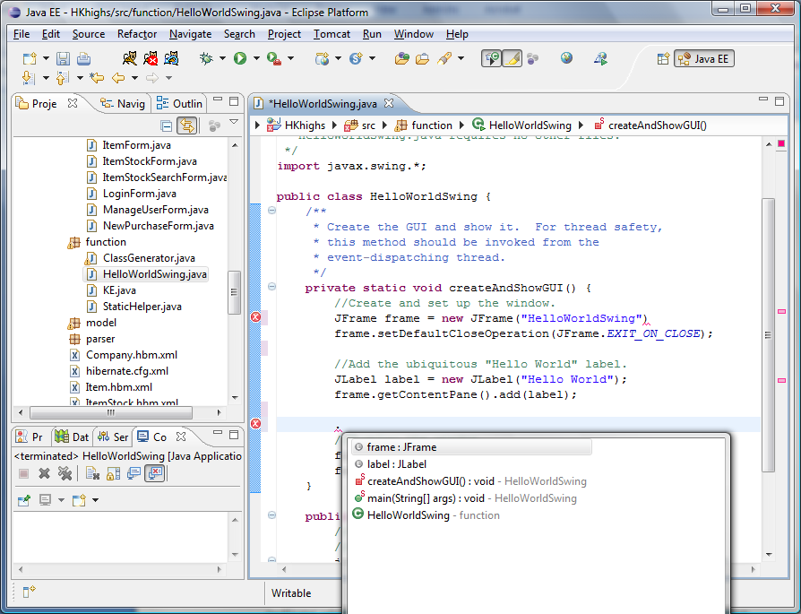

Slide 8
2. Match between system and the real world
First of all, it is Java
It follows Java convention
It consists of 18 public packages of Java classes
Its classes and methods are reasonably named
Unless you are the first time programmer, you don’t have to worry about its syntax or convention
JLabel developerNameLabel = new javax.swing.JLabel();
developerNameLabel.setFont(new java.awt.Font("Arial", 0, 14));
developerNameLabel.setForeground(new java.awt.Color(255, 255, 255));

Slide 9
3. User control and freedom
Eclipse supports strong undo and redo features
You can’t possibly go wrong and have to rewrite every code
You can always fix it even though it may take you some effort and time
Java Swing also provides undo and redo package
javax.swing.event.UndoableEditEvent;
javax.swing.event.UndoableEditListener;
javax.swing.undo.UndoableEdit;

Slide 10
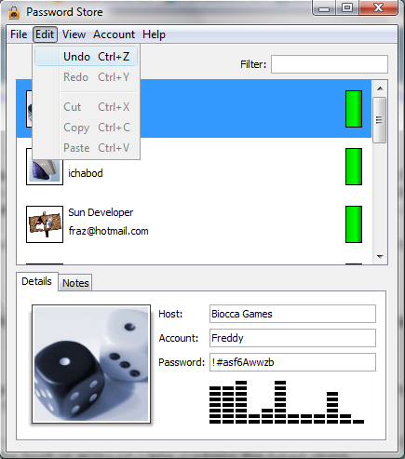

Slide 11
4. Consistency and standards
Similar to #2
Java Swing follows Java convention
Packages, classes, methods, parameters, variables
Mainly constructor, getter, setter

Slide 12
5. Error prevention
First of all, Java is a strongly typed language: primitives and objects
Eclipse checks for syntax and type errors continuously
It gives red underline to errors and small red box to let you know which line in document it is located
If you move your mouse over the error, then it suggests possible solutions to the error
If you think one of the suggestions is a solution, then simply click on it to apply it
Of course, it won’t compile and run until you fix all the syntax errors
However, you don’t have any idea about runtime errors except that you will have to run it and find out

Slide 13
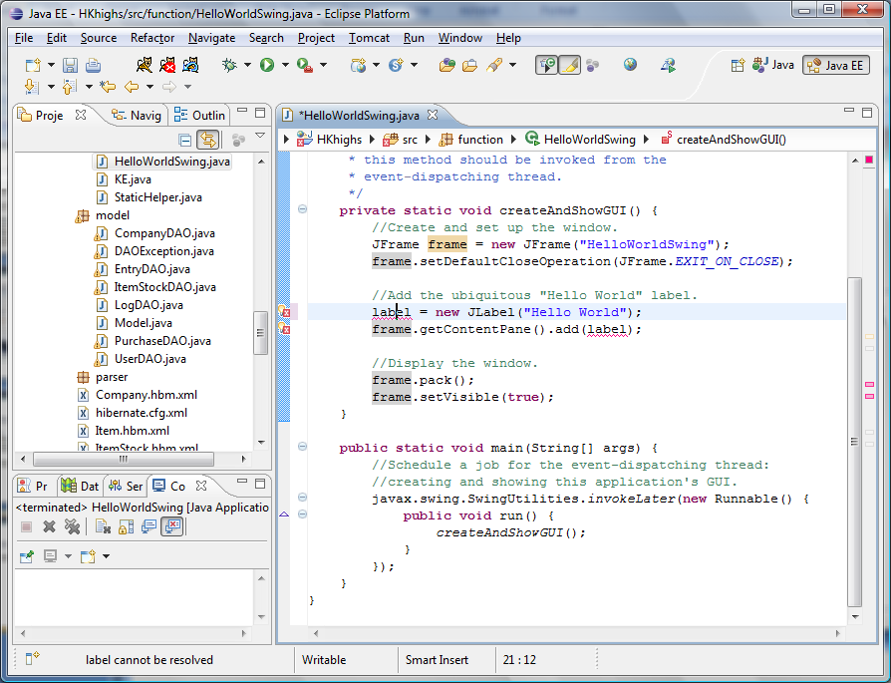
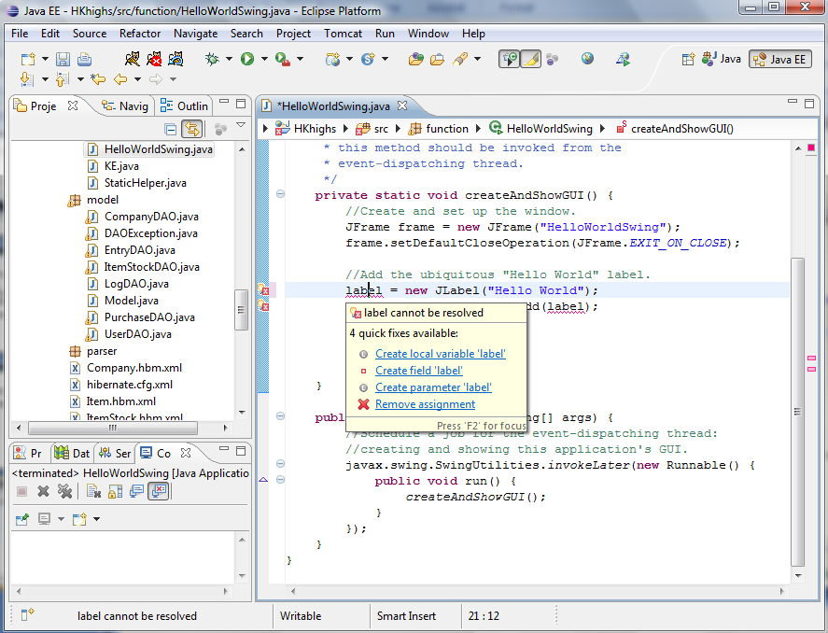

Slide 14
6. Recognition rather than recall
It’s a programming language, so it’s better and faster for you if you memorize names and their functions of classes or methods
However, whenever you press ‘dot’ after name of package, class, or object, then eclipse provides you a list of all possible subclasses, functions and variables
If you move your mouse over almost anything, then eclipse provides you with a text document associated with it, usually javadoc, or you can click on it and it directs you to online javadoc page
You don’t have a help of graphical interface to develop a graphical interface, so it maybe a disadvantage of Java Swing with eclipse.
By the way, you can have a graphical interface if you use NetBeans IDE instead of eclipse

Slide 15
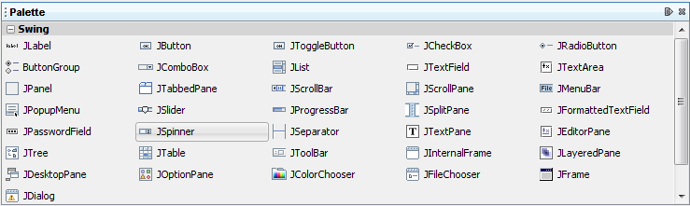
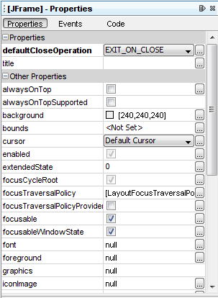
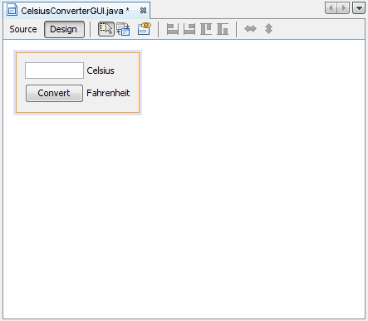

Slide 16
7. Flexibility and efficiency of use
Swing includes many basic components as a package, so it is efficient to use them
At the same time, you can create almost anything you want as combination of those components and some pure coding in Java
Java have had a reputation for being slower and requiring more memory than those written in natively compiled languages such as C or C++
However, the performance heavily depends on how you optimize your codes and which components of UI you use the most frequently
It may be subsequently slower or faster

Slide 17
8. Aesthetic and minimalist design
Swing is designed in a way that it provides a set of "lightweight" (all-Java language) components that, to the maximum degree possible, work the same on all platforms
It includes almost only and all components we could find around any software with user interface
Yet, it gives developers varieties to customize those components

Slide 18
9. Help users recognize, diagnose, and recover from errors
Syntax and type checking errors are already covered previously
Java shows where in the code runtime errors (exceptions) are caused, specifying line numbers and brief reason for error on the console of eclipse
It’s not always right, but most of the times it is right
It’s relatively easy to find the cause of the error and debug it comparing to other languages I have experienced with

Slide 19
GUI terminology
window: A first-class citizen of the graphical desktop.
  Also called a top-level container.
  examples: frame, dialog box, applet
component: A GUI widget that resides in a window.
  Also called controls in many other languages.
  examples: button, text box, label
container: A logical grouping for storing components.
  examples: panel, box

Slide 20
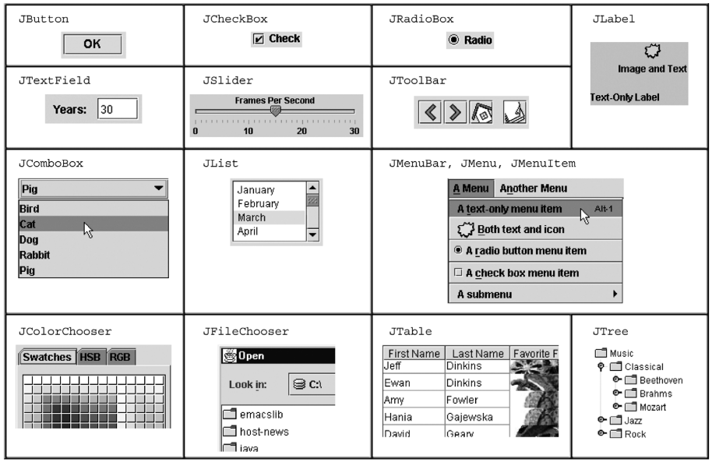
Components

Slide 21
Swing inheritance hierarchy
Component (AWT)
  Window
    Frame
      JFrame (Swing)
      JDialog
  Container
    JComponent (Swing)
      JButton JColorChooser JFileChooser
      JComboBox JLabel JList
      JMenuBar JOptionPane JPanel
      JPopupMenu JProgressBar JScrollbar
      JScrollPane JSlider JSpinner
      JSplitPane JTabbedPane JTable
      JToolbar JTree JTextArea
      JTextField ...
import java.awt.*;
import javax.swing.*;

Slide 22
Component properties
  Each has a get (or is) accessor and a set modifier method.
  examples: getColor, setFont, setEnabled, isVisible
name | type | description
background | Color | background color behind component
border | Border | border line around component
enabled | boolean | whether it can be interacted with
focusable | boolean | whether key text can be typed on it
font | Font | font used for text in component
foreground | Color | foreground color of component
height, width | int | component's current size in pixels
visible | boolean | whether component can be seen
tooltip text | String | text shown when hovering mouse
size, minimum / maximum / preferred size | Dimension | various sizes, size limits, or desired sizes that the component may take

Slide 23
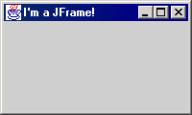
JFrame
a graphical window to hold other components
public JFrame()
public JFrame(String title)
Creates a frame with an optional title.
  Call setVisible(true) to make a frame appear on the screen after creating it.
public void add(Component comp)
Places the given component or container inside the frame.

Slide 24
More JFrame
public void setDefaultCloseOperation(int op)
Makes the frame perform the given action when it closes.
  Common value passed: JFrame.EXIT_ON_CLOSE
  If not set, the program will never exit even if the frame is closed.
public void setSize(int width, int height)
Gives the frame a fixed size in pixels.
public void pack()
Resizes the frame to fit the components inside it snugly.

Slide 25
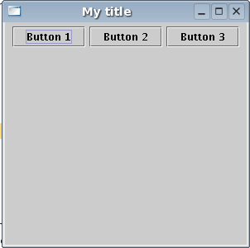
JButton
a clickable region for causing actions to occur
public JButton(String text)
Creates a new button with the given string as its text.
public String getText()
Returns the text showing on the button.
public void setText(String text)
Sets button's text to be the given string.

Slide 26
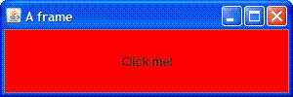
GUI example
import java.awt.*; // Where is the other button?
import javax.swing.*;
public class GuiExample1 {
public static void main(String[] args) {
JFrame frame = new JFrame();
frame.setDefaultCloseOperation(JFrame.EXIT_ON_CLOSE);
frame.setSize(new Dimension(300, 100));
frame.setTitle("A frame");
JButton button1 = new JButton();
button1.setText("I'm a button.");
button1.setBackground(Color.BLUE);
frame.add(button1);
JButton button2 = new JButton();
button2.setText("Click me!");
button2.setBackground(Color.RED);
frame.add(button2);
frame.setVisible(true);
}
}

Slide 27
Sizing and positioning
How does the programmer specify where each component appears, how big each component should be, and what the component should do if the window is resized / moved / maximized / etc.?
Absolute positioning (C++, C#, others):
Programmer specifies exact pixel coordinates of every component.
  "Put this button at (x=15, y=75) and make it 70x31 px in size."
Layout managers (Java):
Objects that decide where to position each component based on some general rules or criteria.
  "Put these four buttons into a 2x2 grid and put these text boxes in a horizontal flow in the south part of the frame."

Slide 28
Layout managers
Objects that decide where to position each component based on some general rules or criteria.
"Put these four buttons into a 2x2 grid and put these text boxes in a horizontal flow in the south part of the frame”.
FlowLayout
BorderLayout
GridLayout
  ."

Slide 29
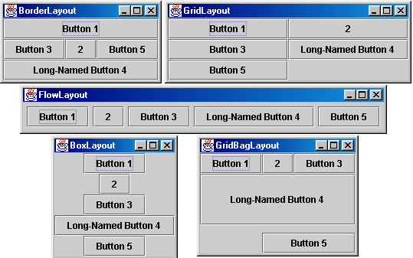
Containers and layout
Place components in a container; add the container to a frame.
  container: An object that stores components and governs their positions, sizes, and resizing behavior.

Slide 30
JFrame as container
A JFrame is a container. Containers have these methods:
public void add(Component comp)
public void add(Component comp, Object info)
Adds a component to the container, possibly giving extra information about where to place it.
public void remove(Component comp)
public void setLayout(LayoutManager mgr)
Uses the given layout manager to position components.
public void validate()
Refreshes the layout (if it changes after the container is onscreen).

Slide 31

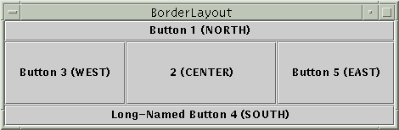
Preferred sizes
Swing component objects each have a certain size they would "like" to be: Just large enough to fit their contents (text, icons, etc.).
  This is called the preferred size of the component.
  Some types of layout managers (e.g. FlowLayout) choose to size the components inside them to the preferred size.
  Others (e.g. BorderLayout, GridLayout) disregard the preferred size and use some other scheme to size the components.
Buttons at preferred size: Not preferred size:

Slide 32
FlowLayout
public FlowLayout()
treats container as a left-to-right, top-to-bottom "paragraph".
  Components are given preferred size, horizontally and vertically.
  Components are positioned in the order added.
  If too long, components wrap around to the next line.
myFrame.setLayout(new FlowLayout());
myFrame.add(new JButton("Button 1"));
  The default layout for containers other than JFrame (seen later).

Slide 33
BorderLayout
public BorderLayout()
Divides container into five regions:
  NORTH and SOUTH regions expand to fill region horizontally,
  and use the component's preferred size vertically.
  WEST and EAST regions expand to fill region vertically,
  and use the component's preferred size horizontally.
  CENTER uses all space not occupied by others.
  myFrame.setLayout(new BorderLayout());
  myFrame.add(new JButton("Button 1"), BorderLayout.NORTH);
  This is the default layout for a JFrame.

Slide 34
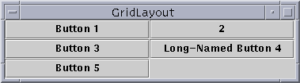
GridLayout
public GridLayout(int rows, int columns)
Treats container as a grid of equally-sized rows and columns.
Components are given equal horizontal / vertical size, disregarding preferred size.
Can specify 0 rows or columns to indicate expansion in that direction as needed.

Slide 35
Event Listeners

Slide 36
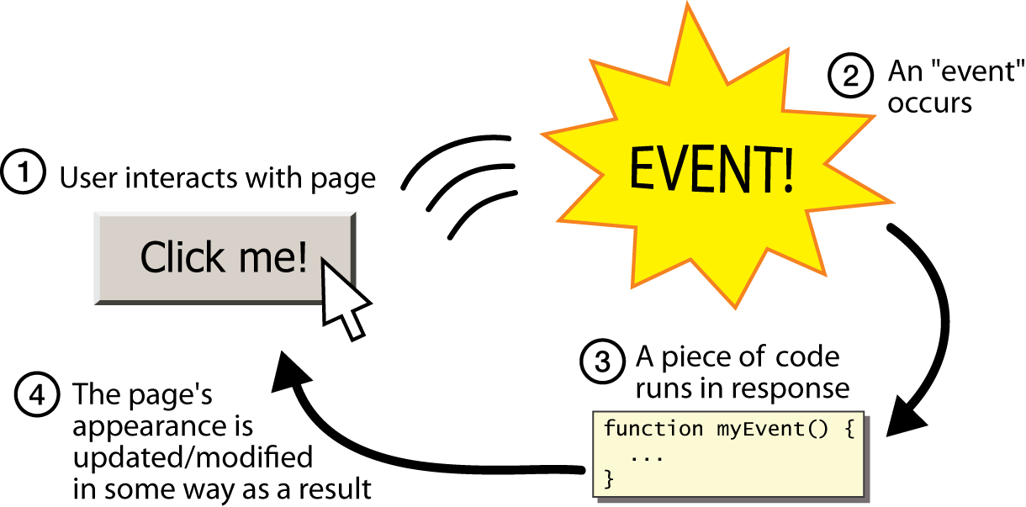
Graphical events
event: An object that represents a user's interaction with a GUI component; can be "handled" to create interactive components.
listener: An object that waits for events and responds to them.
  To handle an event, attach a listener to a component.
  The listener will be notified when the event occurs (e.g. button click).

Slide 37
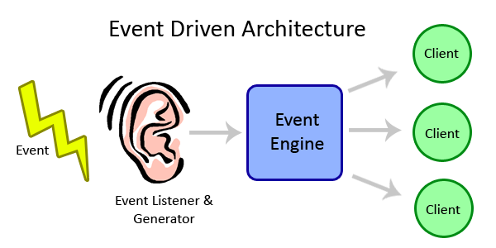
Event-driven programming
event-driven programming: A style of coding where a program's overall flow of execution is dictated by events.
  Rather than a central "main" method that drives execution,
  the program loads and waits for user input events.
  As each event occurs, the program runs particular code to respond.
  The overall flow of what code is executed is determined by the series of events that occur, not a pre-determined order.

Slide 38
Event hierarchy
EventObject
  AWTEvent (AWT)
    ActionEvent
    TextEvent
    ComponentEvent
      FocusEvent
      WindowEvent
      InputEvent
        KeyEvent
        MouseEvent
EventListener
  AWTEventListener
  ActionListener
  TextListener
  ComponentListener
  FocusListener
  WindowListener
  KeyListener
  MouseListener
import java.awt.event.*;

Slide 39

Action events
action event: An action that has occurred on a GUI component.
  The most common, general event type in Swing. Caused by:
    button or menu clicks,
    check box checking / unchecking,
    pressing Enter in a text field, ...
  Represented by a class named ActionEvent
  Handled by objects that implement interface ActionListener

Slide 40
Implementing a listener
public class name implements ActionListener {
public void actionPerformed(ActionEvent event) {
code to handle the event;
}
}
JButton and other graphical components have this method:
  public void addActionListener(ActionListener al)
  Attaches the given listener to be notified of clicks and events that occur on this component.

Slide 41

Nested classes
nested class: A class defined inside of another class.
Usefulness:
  Nested classes are hidden from other classes (encapsulated).
  Nested objects can access/modify the fields of their outer object.
Event listeners are often defined as nested classes inside a GUI.

Slide 42
Nested class syntax
// enclosing outer class
public class name {
...
// nested inner class
private class name {
...
}
}
  Only the outer class can see the nested class or make objects of it.
  Each nested object is associated with the outer object that created it, so it can access/modify that outer object's methods/fields.
    If necessary, can refer to outer object as OuterClassName.this

Slide 43
Static inner classes
// enclosing outer class
public class name {
...
// non-nested static inner class
public static class name {
...
}
}
  Static inner classes are not associated with a particular outer object.
  They cannot see the fields of the enclosing class.
  Usefulness: Clients can refer to and instantiate static inner classes:
    Outer.Inner name = new Outer.Inner(params);

Slide 44
GUI event example
public class MyGUI {
private JFrame frame;
private JButton stutter;
private JTextField textfield;
public MyGUI() {
...
stutter.addActionListener(new StutterListener());
}
...
// When button is clicked, doubles the field's text.
private class StutterListener implements ActionListener {
public void actionPerformed(ActionEvent event) {
String text = textfield.getText();
textfield.setText(text + text);
}
}
}

